Slide 1


Not just a profile. Your proof of growth.
A full-stack MERN platform built for students, recruiters, and mentors — enabling continuous professional development, not just job search.
GPI / CLOUD COUNSELAGE INTERNSHIP PROJECT

Slide 2

The Problem
GPI Problem Statement
Existing Tools Fall Short
Higher-education students lack a dedicated platform for continuous professional development. The gap between Year 1 and final year goes completely untracked — no skill roadmaps, no evidence of work, no mentorship journeys recorded.
LinkedIn
Built for professionals, not for 1st–4th year students building their first profile.
Unstop / Internshala
Focus on competitions and job listings — no growth tracking or mentorship depth.
All Platforms
Generic skill tags. No evidence. No roadmap. No reflection. No proof of growth.

Slide 3
Objectives & User Roles
Project Objectives
User Roles
1
Build a real MERN full-stack application
Frontend SPA + REST API + database, all production-deployed.
Student
2
Support continuous student growth
Build profile, track skills, apply for jobs, request mentorship, grow continuously.
Skill roadmaps, evidence portfolios, and reflection journals across semesters.
3
Unify networking, jobs & mentorship
One platform for students, recruiters, and mentors to interact meaningfully.
Recruiter
4
Integrate AI for career guidance
Post jobs, manage applicant pipeline, review evidence portfolios and resumes.
Jarvis AI assistant provides profile-aware suggestions — not generic chatbot answers.
Mentor
Create mentorship offers, manage session requests, give structured guidance.

Slide 4
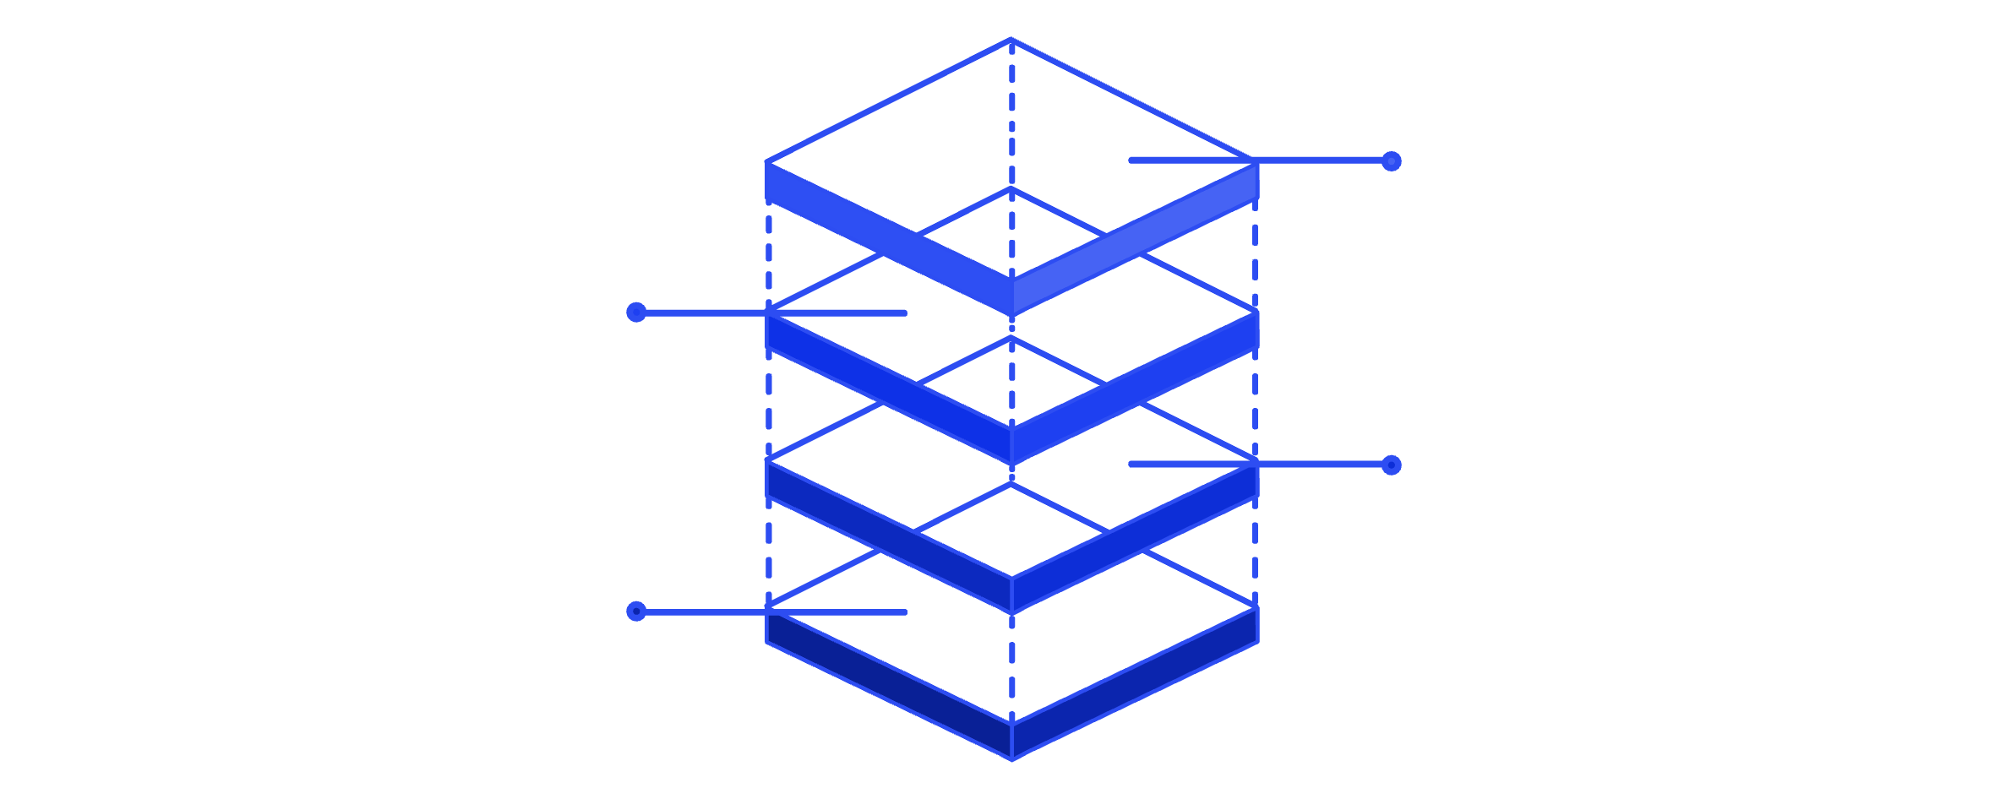

Technical Architecture & Stack
Data & AI
MongoDB Atlas (Mongoose) + OpenAI API
Express API
Node.js REST endpoints and middleware
Client Router
React Router, Context, Axios
React SPA
TypeScript + Vite single-page app
Frontend
Backend
Security
Database & AI
React 18 + TypeScript
Vite SPA build
React Router v6
Context API + Hooks
MUI v5 + Glassmorphism CSS
Axios for API calls
Node.js + Express
REST API architecture
Modular route structure
Middleware pipeline
.env for all secrets
JWT via httpOnly cookies
bcrypt password hashing
helmet HTTP headers
cors configuration
express-rate-limit
MongoDB Atlas cloud
Mongoose ODM schemas
OpenAI API (via .env)
No hardcoded secrets
100% Free & OSS ✅
All tools are free and open-source — fully compliant with GPI / Cloud Counselage internship requirements.

Slide 5

Student Experience
LinkedIn-Like Foundations
New Student-Focused Features
Rich Profile
🗺 Skill Pathway Map
Education, experience, skills, social links, and resume URL — all in one place.
Visual roadmap of skills per career goal — colour-coded as To Learn / In Progress / Verified.
Connections & Messaging
Send connection requests and chat 1-1 with peers, mentors, and recruiters.
📁 Evidence Portfolio
Proof Ledger: evidence cards for projects, hackathons, courses, and internship tasks — backed by GitHub and demo links.
Feed, Jobs & Applications
Post updates, search jobs, apply, and track every application through a clear pipeline.
📈 Growth Timeline & Journal
Reflection entries combined with a timeline of skills, projects, and events across semesters.

Slide 6



Recruiter & Mentor Experience
Recruiter Dashboard
Mentor Dashboard
Post jobs and internships with required skills and full details
Dashboard shows all jobs with candidate counts per pipeline stage
Detailed applicant view: profile, skills, evidence cards, resume preview
Update status: Applied → Shortlisted → Test → Interview → Offer → Rejected
Add internal notes and start direct chat with any applicant
Create a mentor profile: expertise, company, availability, languages
Publish structured mentorship offers and programmes
Dashboard: view session requests, accept / reject, schedule, mark completed
Students browse mentors, request sessions, and leave reviews post-session
Feedback loop improves mentor visibility and student trust
PathPort goes beyond job boards by combining transparent hiring pipelines with structured, trackable mentorship — all in one platform.

Slide 7

Key Innovations vs LinkedIn / Unstop / Internshala
Skill Pathway Map
Evidence-Based Portfolio
Goal-based, interactive skill roadmap with status colours (To Learn / In Progress / Verified). No other platform does this for students.
Every skill claim is backed by real work — GitHub links, demos, docs, and task records. Not just tags.
Opportunity Quality Index (OQI)
Transparent Application Pipeline
Jobs scored 0–100 from student reviews on learning, support, and fairness. Shown as green / yellow / red badges to protect students from low-quality internships.
Clear stage-by-stage visibility for both students and recruiters — no black-box hiring.
Growth Timeline & Reflection Journal
Jarvis AI & Career Translator
Track professional evolution semester by semester. Combines events, skills, projects, and personal reflections in one view.
Profile-aware skill suggestions, project ideas, cover letters, and conversion of casual text into professional CV bullets — powered by OpenAI, not a generic chatbot.
Why PathPort is best for students: It proves skills with evidence, supports long-term growth across all four years, and protects students from low-quality opportunities via OQI scoring.

Slide 8
Deployment, Compliance & Future Scope
Deployment & Compliance ✅
Future Roadmap
Backend → Render
Frontend → Vercel
Real-Time Messaging
Node.js + Express API deployed on Render with MongoDB Atlas as cloud database.
React + Vite SPA deployed on Vercel with environment-variable-driven API URLs.
Socket.io integration for live chat between students, recruiters, and mentors.
Video Mentorship Calls
Zero Hardcoded Secrets
Demo Accounts Ready
In-platform video sessions with recording and note-taking capabilities.
All API keys, DB URIs, and JWT secrets stored in .env — fully compliant with Cloud Counselage rules.
Pre-filled realistic data for student, recruiter, and mentor roles — evaluator-ready.
Resume PDF Generator
Auto-generate a formatted resume from the student's PathPort profile data.
College Admin Analytics & Mobile App
Institutional dashboards for faculty + a native mobile app for on-the-go growth tracking.
PathPort is not only a LinkedIn clone — it is a full-stack platform for continuous professional development of students, from Year 1 to placement and beyond.

